Slide 1
Introduction to AI

Slide 2


What is AI in My Life?
Workshop series on Artificial Intelligence
Developed by ADAPT research centre and partners
Designed to help students navigate the ’Age of AI’
Our Partners:
This work is licensed under a Creative Commons Attribution-NonCommercial-ShareAlike 4.0 International License
Notes:
AI in My Life is a modular workshop series on Artificial Intelligence (AI)
It was developed by the Science Foundation Ireland ADAPT Research Centre
ADAPT is a major academia-industry research centre with more than 300 researchers from 8 Irish universities (led by Trinity College Dublin and Dublin City University) producing research and innovations in many aspects of AI
Partners on the project include, for example, DCU Access, Amazon Web Services and the Lero software research centre
AI is transforming life as we know it. While AI offers substantial benefits to individuals and society, it has major implications for privacy, ethics and security. AI in My Life aims to help students navigate this so-called ‘Age of AI’ safely and successfully

Slide 3
What you’ll learn today
Understand what AI is
Explain what we mean by “intelligent”
Be able to cite examples of uses of AI
Our Partners:
This work is licensed under a Creative Commons Attribution-NonCommercial-ShareAlike 4.0 International License

Slide 4
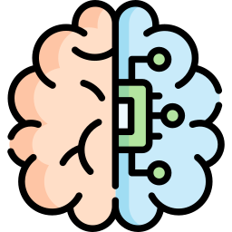
What is AI?
This work is licensed under a Creative Commons Attribution-NonCommercial-ShareAlike 4.0 International License

Slide 5
What is AI?
Artificial intelligence refers to many different technologies that are designed to accomplish tasks that can otherwise be only carried out by human minds, for example identifying patterns, recognising images, understanding languages or solving problems.
This work is licensed under a Creative Commons Attribution-NonCommercial-ShareAlike 4.0 International License

Slide 6
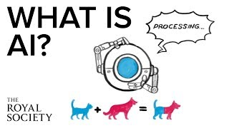
What is AI?
The Royal Society- https://www.youtube.com/watch?v=nASDYRkbQIY&feature=emb_imp_woyt
This work is licensed under a Creative Commons Attribution-NonCommercial-ShareAlike 4.0 International License

Slide 7
Do you use AI?
This work is licensed under a Creative Commons Attribution-NonCommercial-ShareAlike 4.0 International License
Notes:
Wordcloud
AI is ubiquitous, meaning it’s appearing everywhere. It’s playing an increasing role in our everyday lives, so it’s important that we understand it.
Can you think of examples of where/how you use AI-based technology in your daily life?

Slide 8
AI around us
Can you list some everyday items we rely on that use AI?
This work is licensed under a Creative Commons Attribution-NonCommercial-ShareAlike 4.0 International License

Slide 9
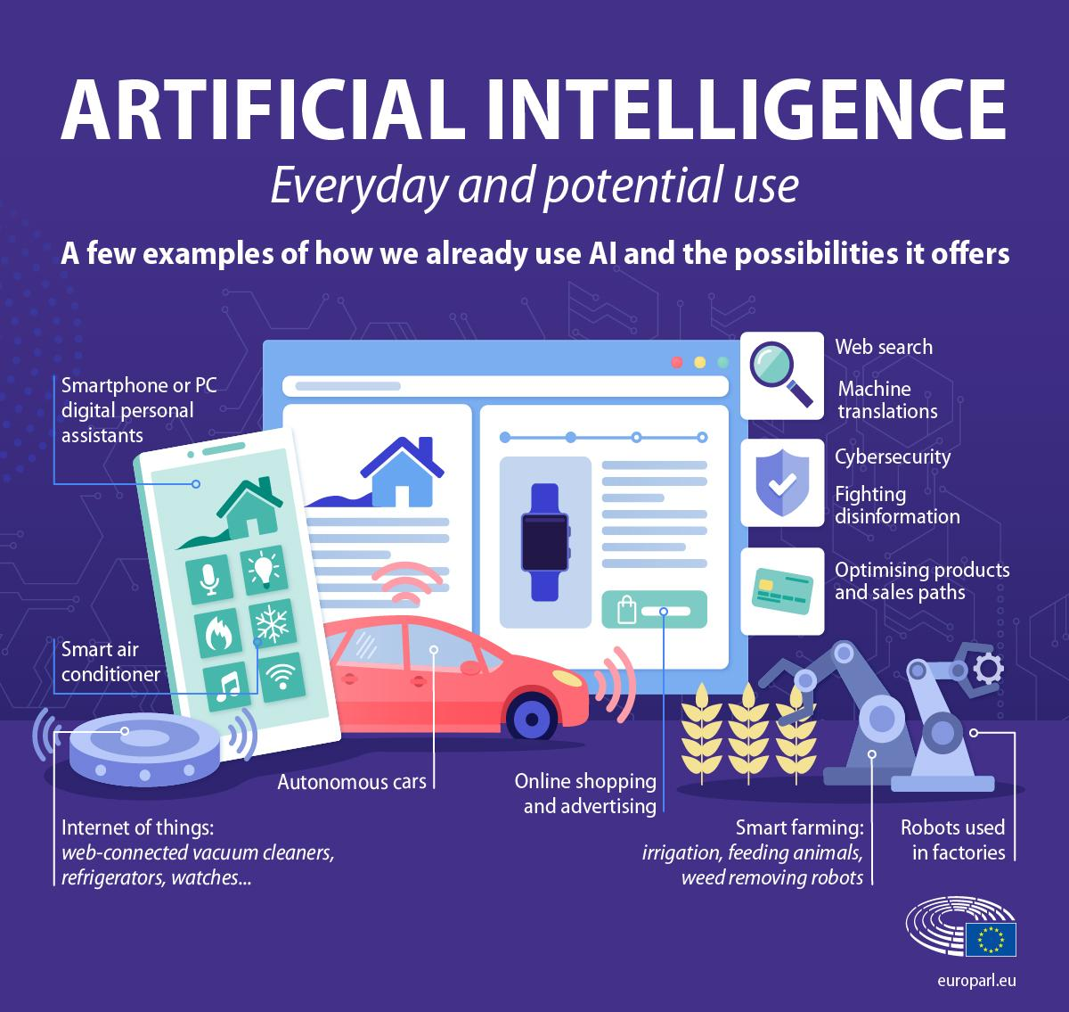
AI around us
Can you list some everyday items we rely on that use AI?
This work is licensed under a Creative Commons Attribution-NonCommercial-ShareAlike 4.0 International License

Slide 10
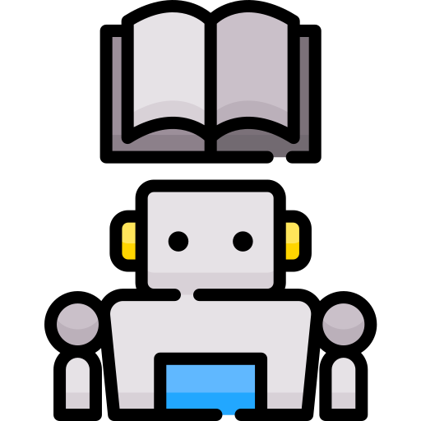
What can AI be used for?
We’re now going to watch some videos that show where researchers and businesses have started to use AI.
Can you think of what the pros and cons of using AI might be?
This work is licensed under a Creative Commons Attribution-NonCommercial-ShareAlike 4.0 International License

Slide 11

Video A - Discuss
Machine Learning:
A Whale Tale - The Big Idea
Amazon Web Services
Meet a marine biologist who has spent her career trying to better understand sperm whales. A self-described "technophobe”, she now embraces machine learning models to understand more about these marine mammals so that they stand a better chance at survival.
How is AI used by this company/organisation?
Could this be done without AI?
Are there any downsides to this approach?
https://youtu.be/ZZs4R-5u4g4
This work is licensed under a Creative Commons Attribution-NonCommercial-ShareAlike 4.0 International License
Notes:
Could this be done without AI?
Are there any downsides to this approach?

Slide 12
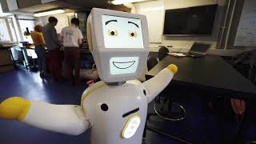
Video B - Discuss
AI is helping to advance the health of people and communities around the world
‘Stevie II’ – Ireland’s first socially assistive robot with advanced AI features
How is AI used by this research team?
Could this be done without AI?
Are there any downsides to this approach?
https://youtu.be/bRlVtjhkQ8M?si=Th0HkR88esd0bCLa
This work is licensed under a Creative Commons Attribution-NonCommercial-ShareAlike 4.0 International License
Notes:
Could this be done without AI?
Are there any downsides to this approach?

Slide 13
What do we mean by “intelligence”?
Artificial intelligence refers to many different technologies that are designed to accomplish tasks that can otherwise be only carried out by human minds, for example identifying patterns, recognising images, understanding languages or solving problems.
This work is licensed under a Creative Commons Attribution-NonCommercial-ShareAlike 4.0 International License
Notes:
Constellation = group
Comprehend = understand
Sense = detect
Through AI, we can programme machines to plan, learn, reason, solve problems, and make decisions.

Slide 14
AI Capabilities
Computing is about making machines that appear to be intelligent.
How is it done?
What do we mean by human intelligence?
If we identify abilities in humans that require intelligence, we can then build machines to simulate having these abilities.
Take part in a test of intelligence with The Intelligent Piece of Paper activity!
This work is licensed under a Creative Commons Attribution-NonCommercial-ShareAlike 4.0 International License
Notes:
What aspects of human intelligence are most difficult to replicate using AI?

Slide 15

What about recent advances?
Recent advances have achieved progress in delivering some of the harder-to-replicate aspects of intelligence
For example…
https://www.youtube.com/watch?v=bwHOhIkALR4
This work is licensed under a Creative Commons Attribution-NonCommercial-ShareAlike 4.0 International License

Slide 16
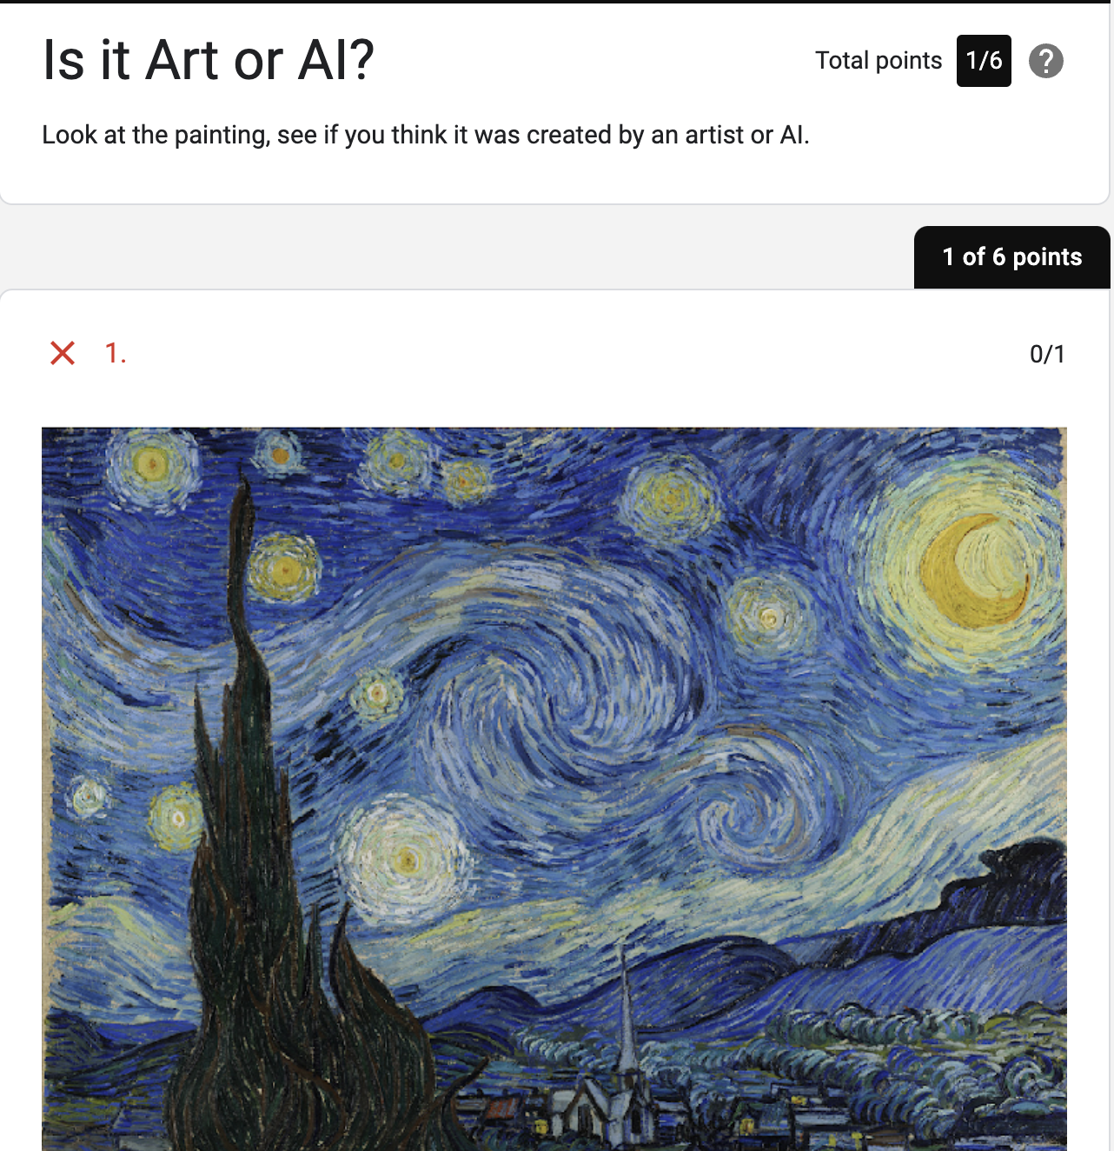
Artist or AI? Quiz
Just how good is Generative AI?
Can you tell the difference between real art or AI?
Give it a go:
https://bit.ly/Art-Or-AI
This work is licensed under a Creative Commons Attribution-NonCommercial-ShareAlike 4.0 International License
Notes:
Focus on fact that outcomes are similar but the underlying processes are completely different

Slide 17
AI Capabilities
Which aspects of “intelligence” do you think machines find hardest to achieve?
This work is licensed under a Creative Commons Attribution-NonCommercial-ShareAlike 4.0 International License
Notes:
What aspects of human intelligence are most difficult to replicate using AI?

Slide 18
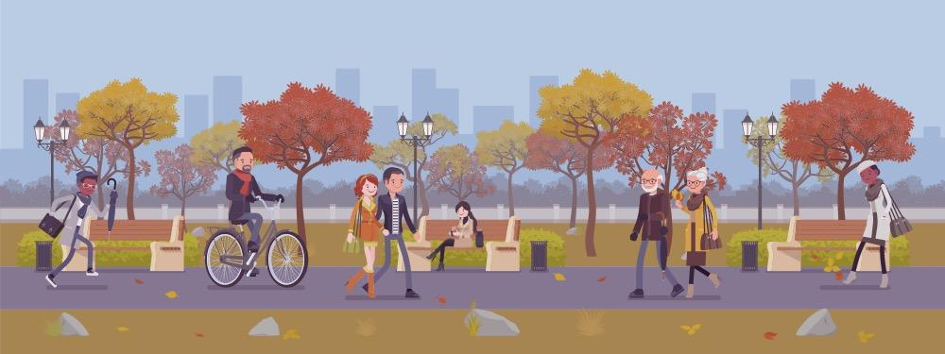
Human Capabilities
Being self-aware
What are humans good at?
Being passionate
Showing compassion
Understanding emotion
Appreciating context
Learning from experience
This work is licensed under a Creative Commons Attribution-NonCommercial-ShareAlike 4.0 International License

Slide 19
What have we learned?
We know what AI is
We know what “intelligent” means
We can give examples of uses of AI
This work is licensed under a Creative Commons Attribution-NonCommercial-ShareAlike 4.0 International License
Notes:
Ask students to indicate what are their key takeaways from this lesson?

Slide 20
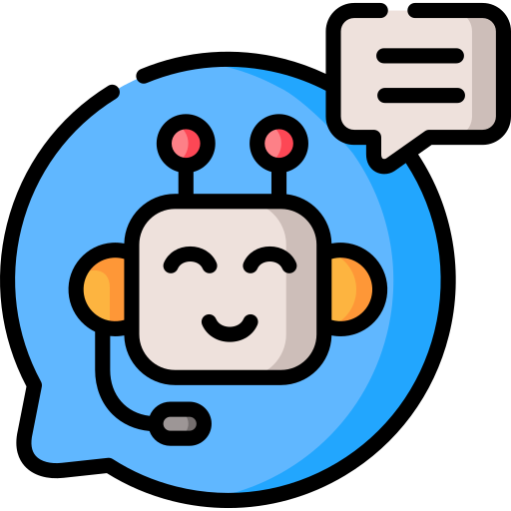
Thanks to our partners:
Want to find out more about AI?
Explore more AI in My Life modules:
www.adaptcentre.ie/projects/ai-in-my-life/
Notes:
Add examples like previous slide

Slide 21
Thanks to our partners:
Optional Extra Starter Activity
Notes:
Add examples like previous slide

Slide 22
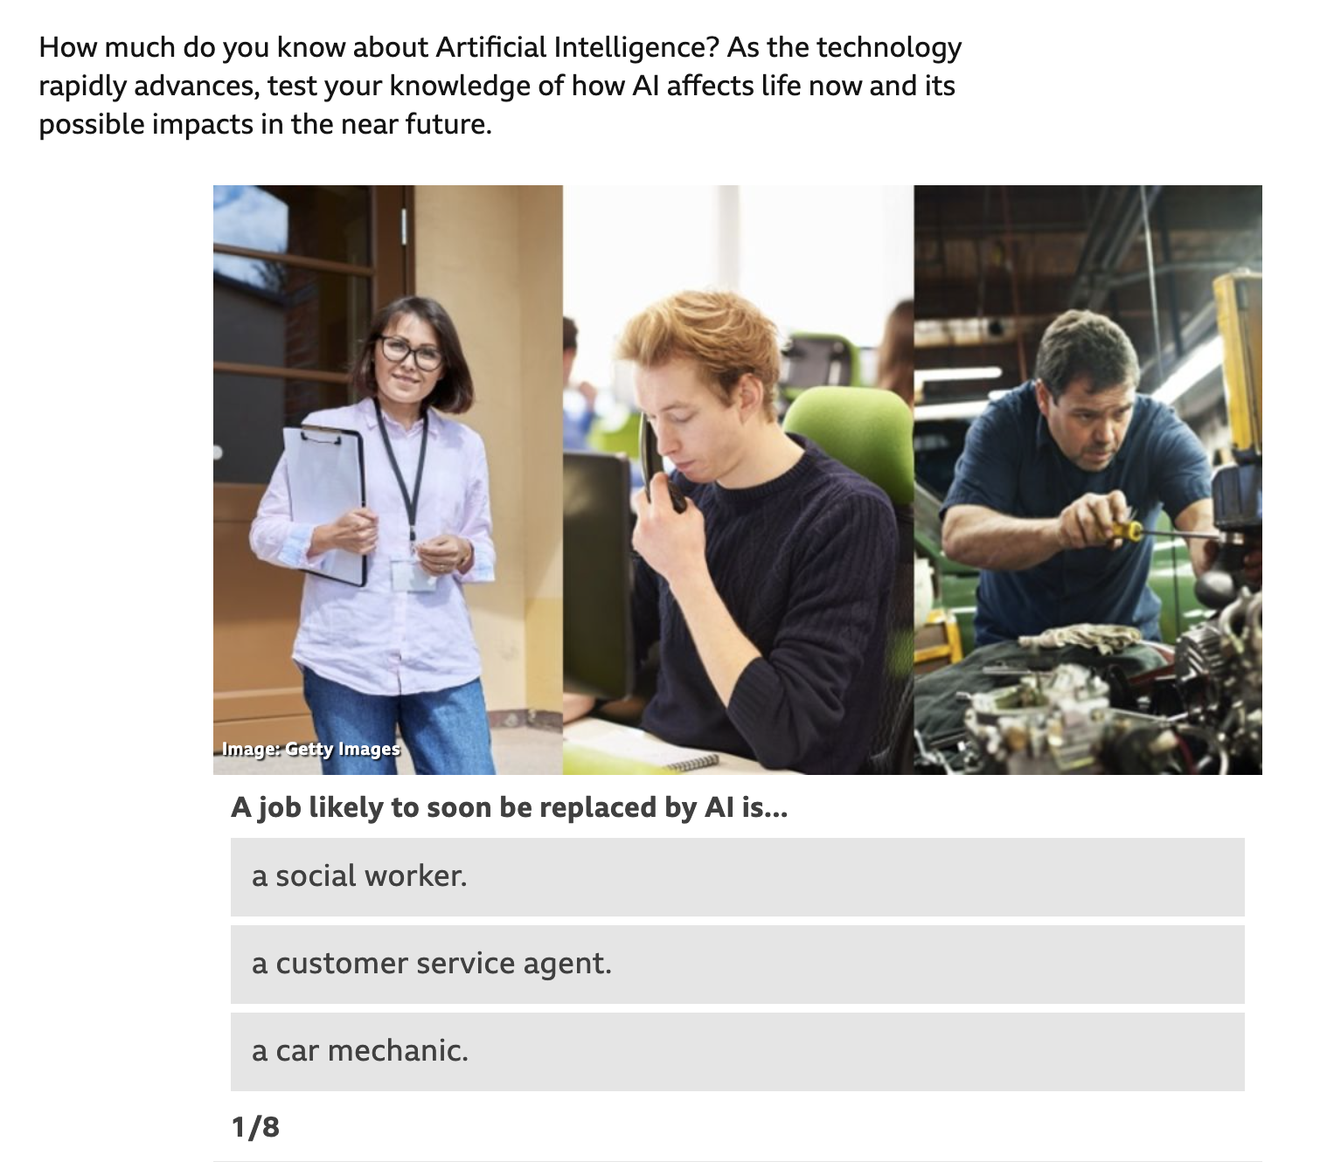

Think you know about AI?
Quiz Time!
Go to:
bit.ly/AIQuizTime
This work is licensed under a Creative Commons Attribution-NonCommercial-ShareAlike 4.0 International License

